Slide 1
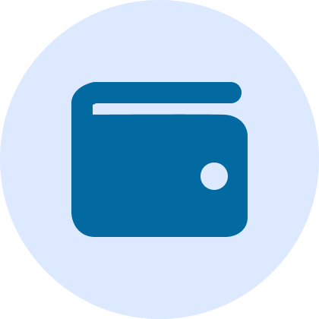
SpendWise - Expense Tracker
TEAM ZENITH
Gain Financial Insights

Slide 2



TEAM ZENITH
PAYAL MAKWANA
JAHNVI AGHERA
ADITYA RAJ

Slide 3
PROBLEM STATEMENT
Build a personal finance web app to track spending and manage budgets.
It shows a dashboard to help users understand where their money goes.

Slide 4
INTRODUCTION
What is this Project?
Purpose
A personal finance web application designed to help users track their spending, manage budgets, and gain insights into their financial habits.
Many individuals struggle to track their spending habits and manage budgets effectively. Empower users to make informed financial decisions with an intuitive dashboard and tools.

Slide 5
Our web application provides:
A centralized platform to track income and expenses.
Budget alerts to prevent overspending.
Visual charts to understand spending habits.
Mobile-friendly design for on-the-go tracking.
We can export our transactions in pdf/ csv format.
AI ChatBot (Cashy) for help

Slide 6
TECHNOLOGY STACK
FRONTEND
BACKEND
HTML, CSS, JavaScript
PHP for server-side logic and APIs
DATABASE
DEPLOYMENT
PHP - MySQL for storing user data securely.
Hosted at zenith24ttt.ct.ws

Slide 7
USER JOURNEY
Dashboard
Register/ Login
Landing Page
Add/ Edit/ Delete Transaction
View
Insights
Export Data

Slide 8
CHALLENGES FACED
Ensuring secure authentication and
data management (e.g. secure_config.php)
Optimizing mobile responsiveness for better usability on smaller screens
Implementing recurring transactions functionality seamlessly

Slide 9


Slide 10
User Authentication

Slide 11
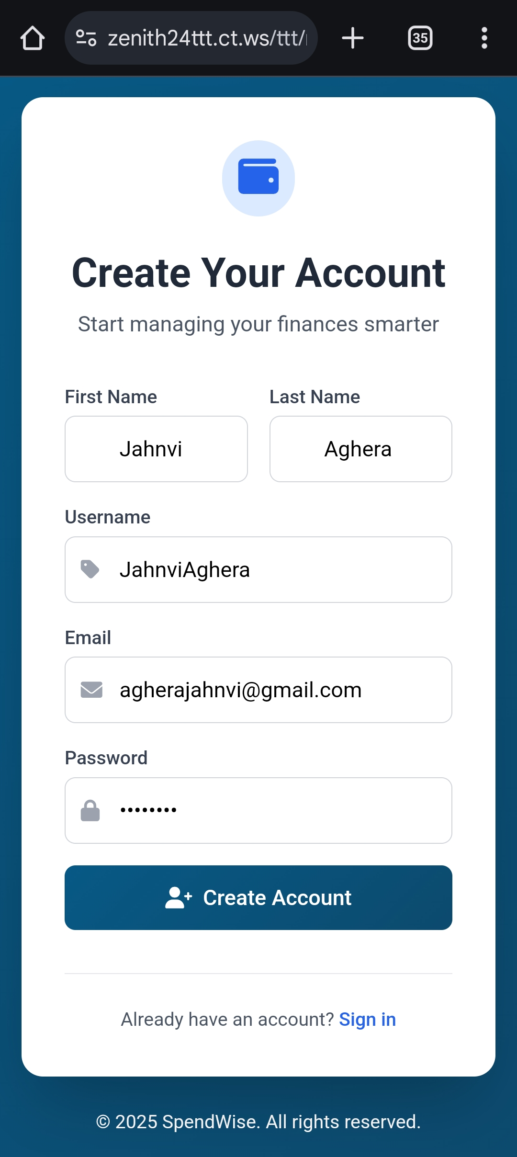

Slide 12
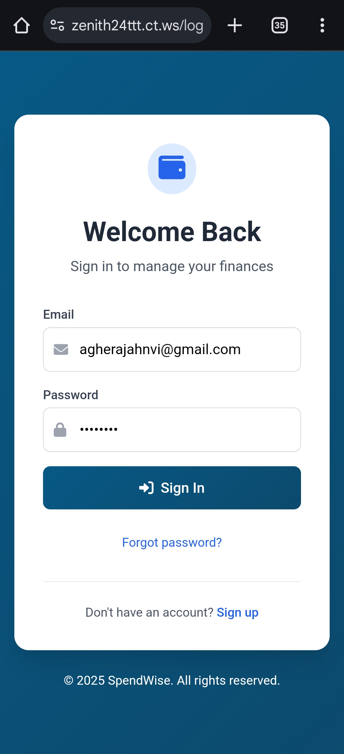

Slide 13
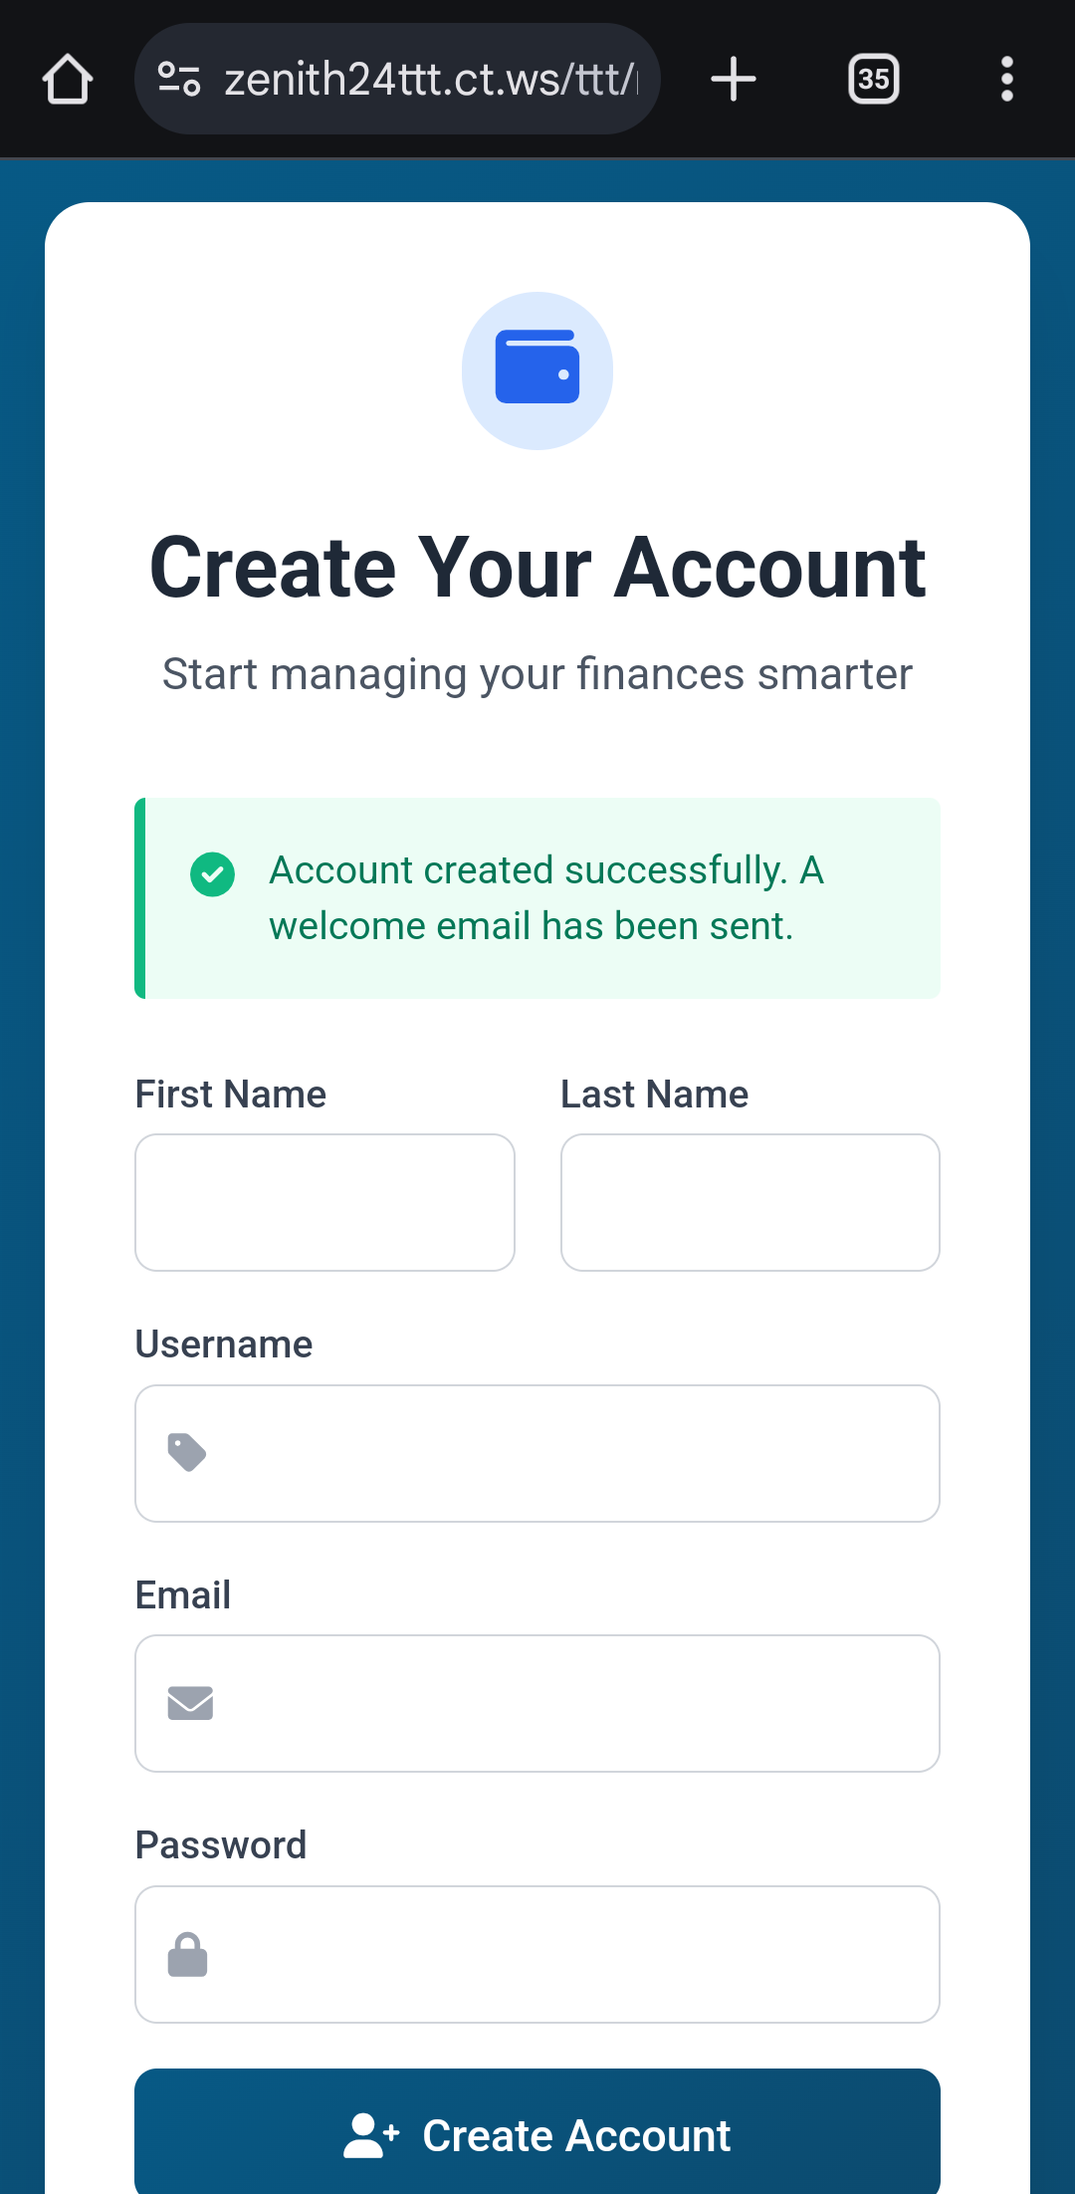

Slide 14
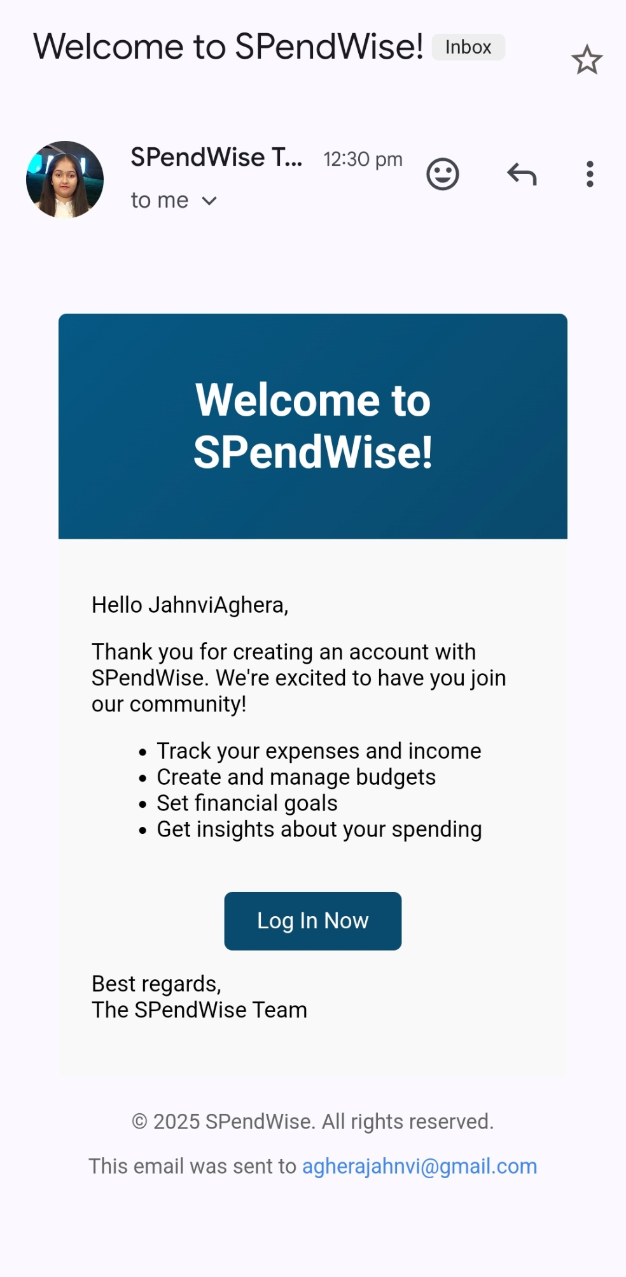

Slide 15
Dashboard

Slide 16
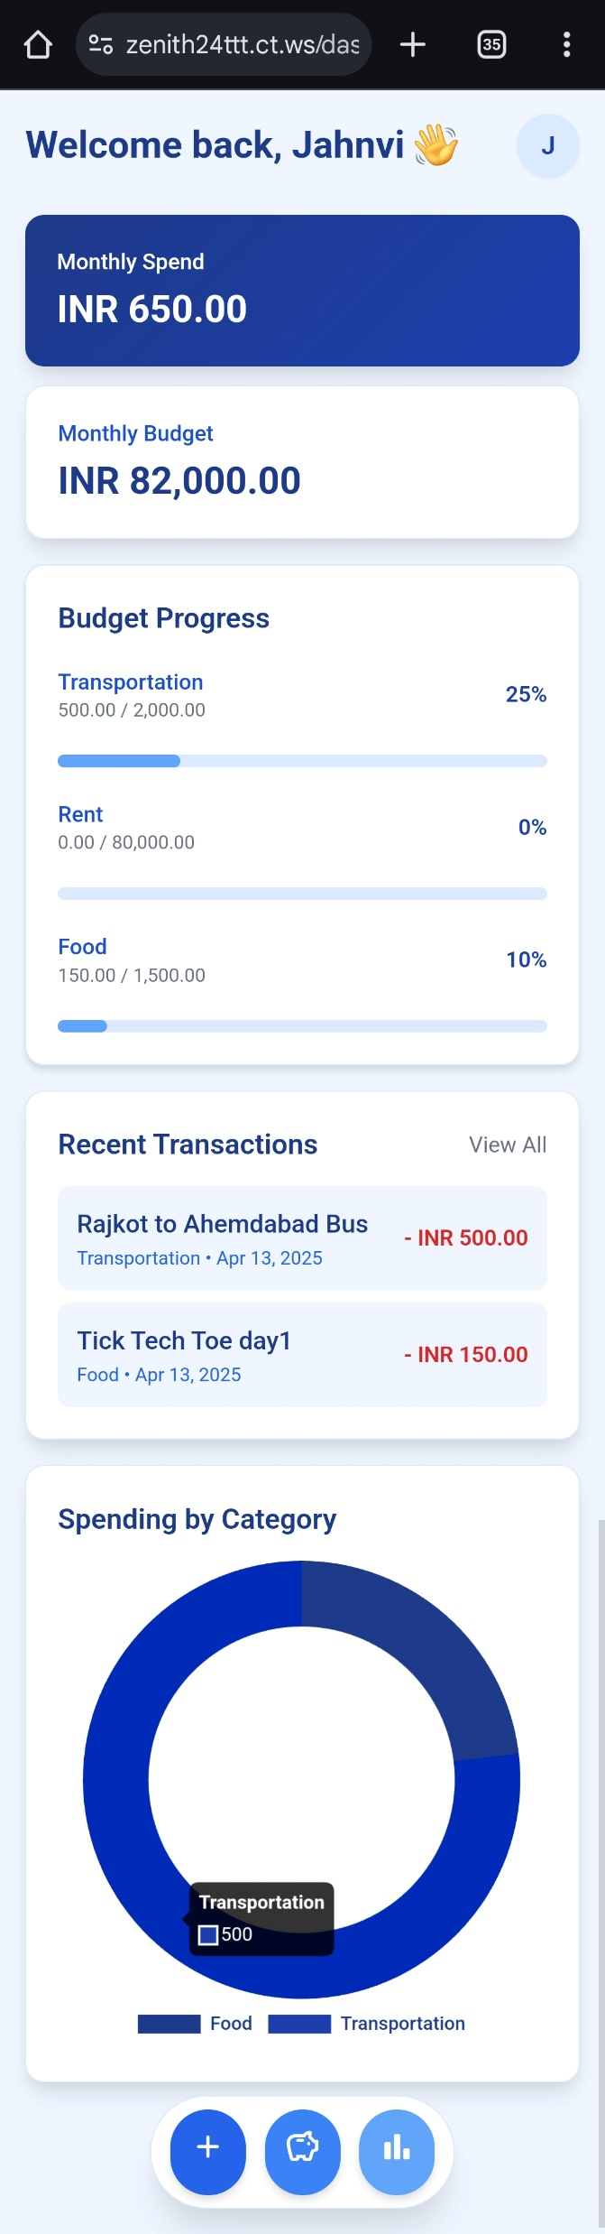

Slide 20
Add Budget

Slide 21
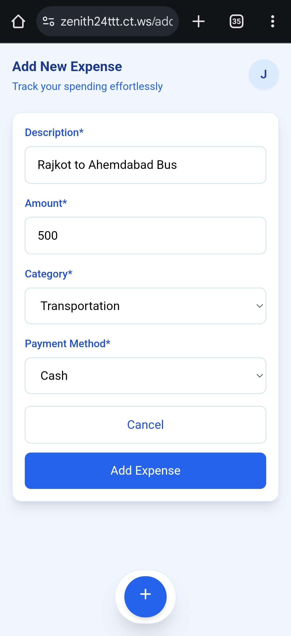

Slide 24
Record Expense

Slide 25
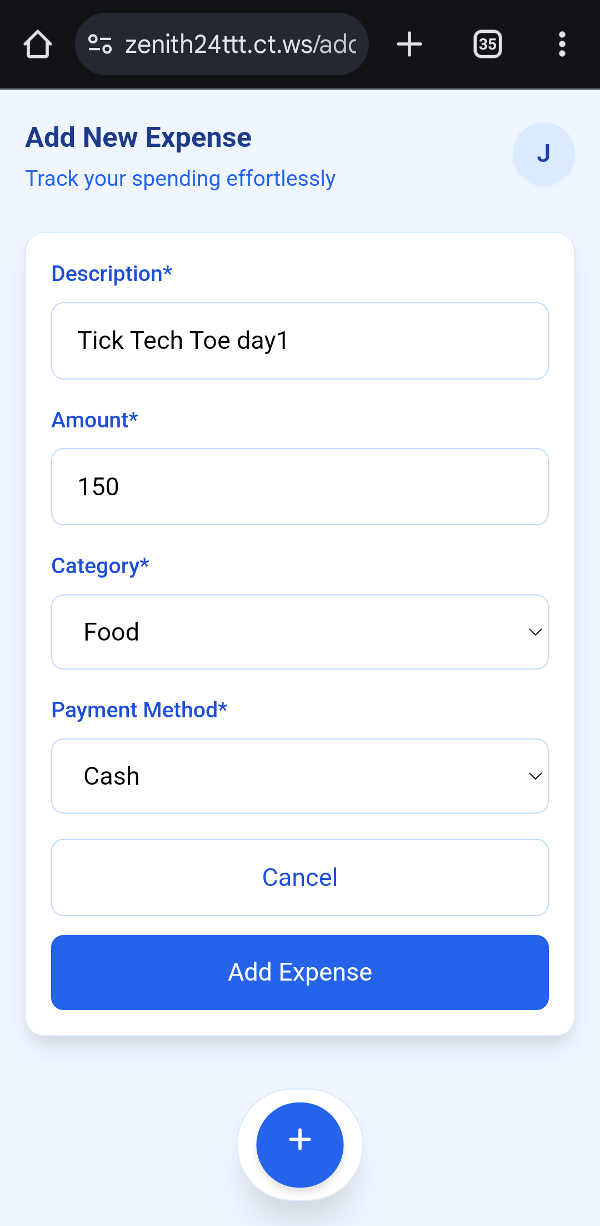

Slide 28
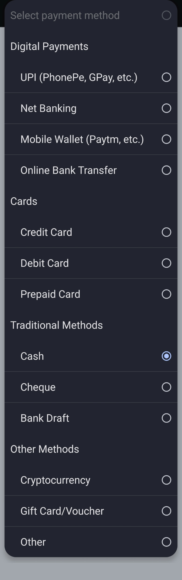

Slide 31
Manage Transactions

Slide 32
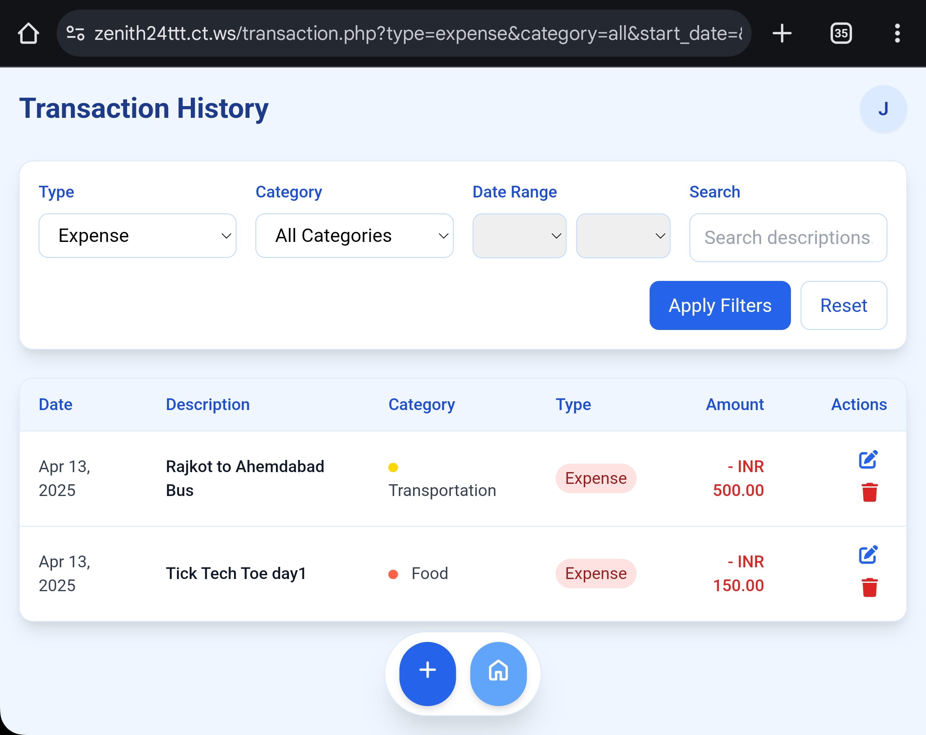

Slide 34
Export Transactions

Slide 35
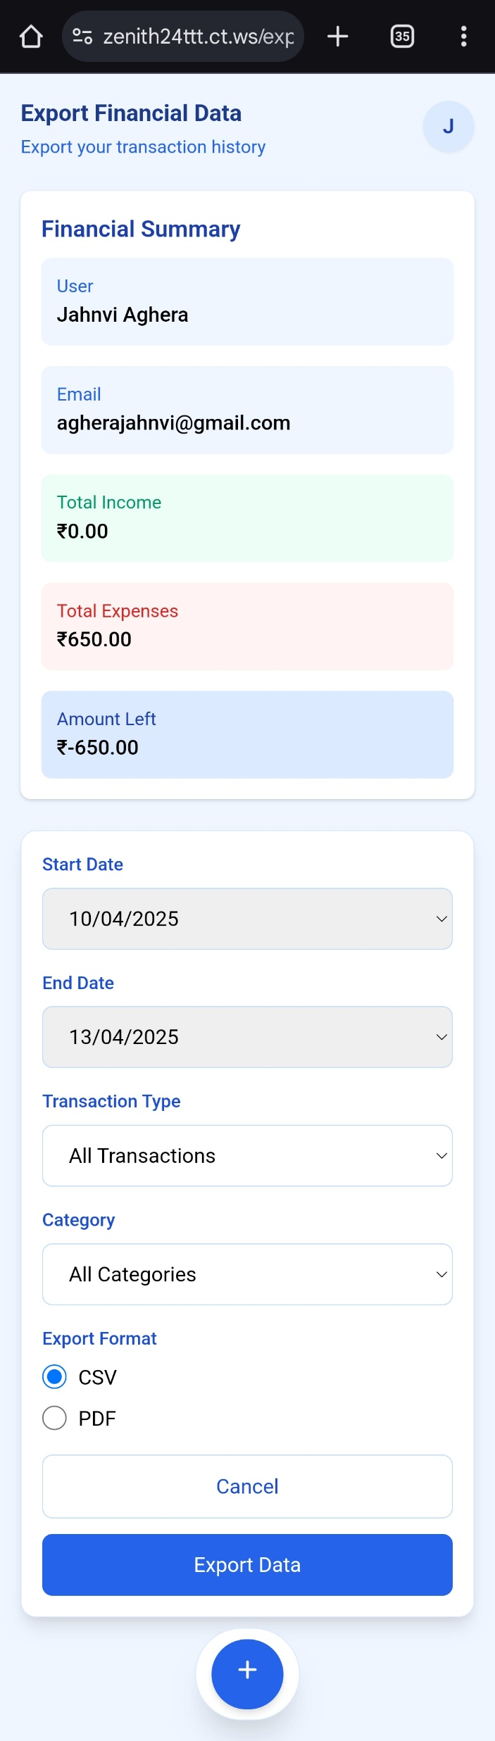

Slide 39
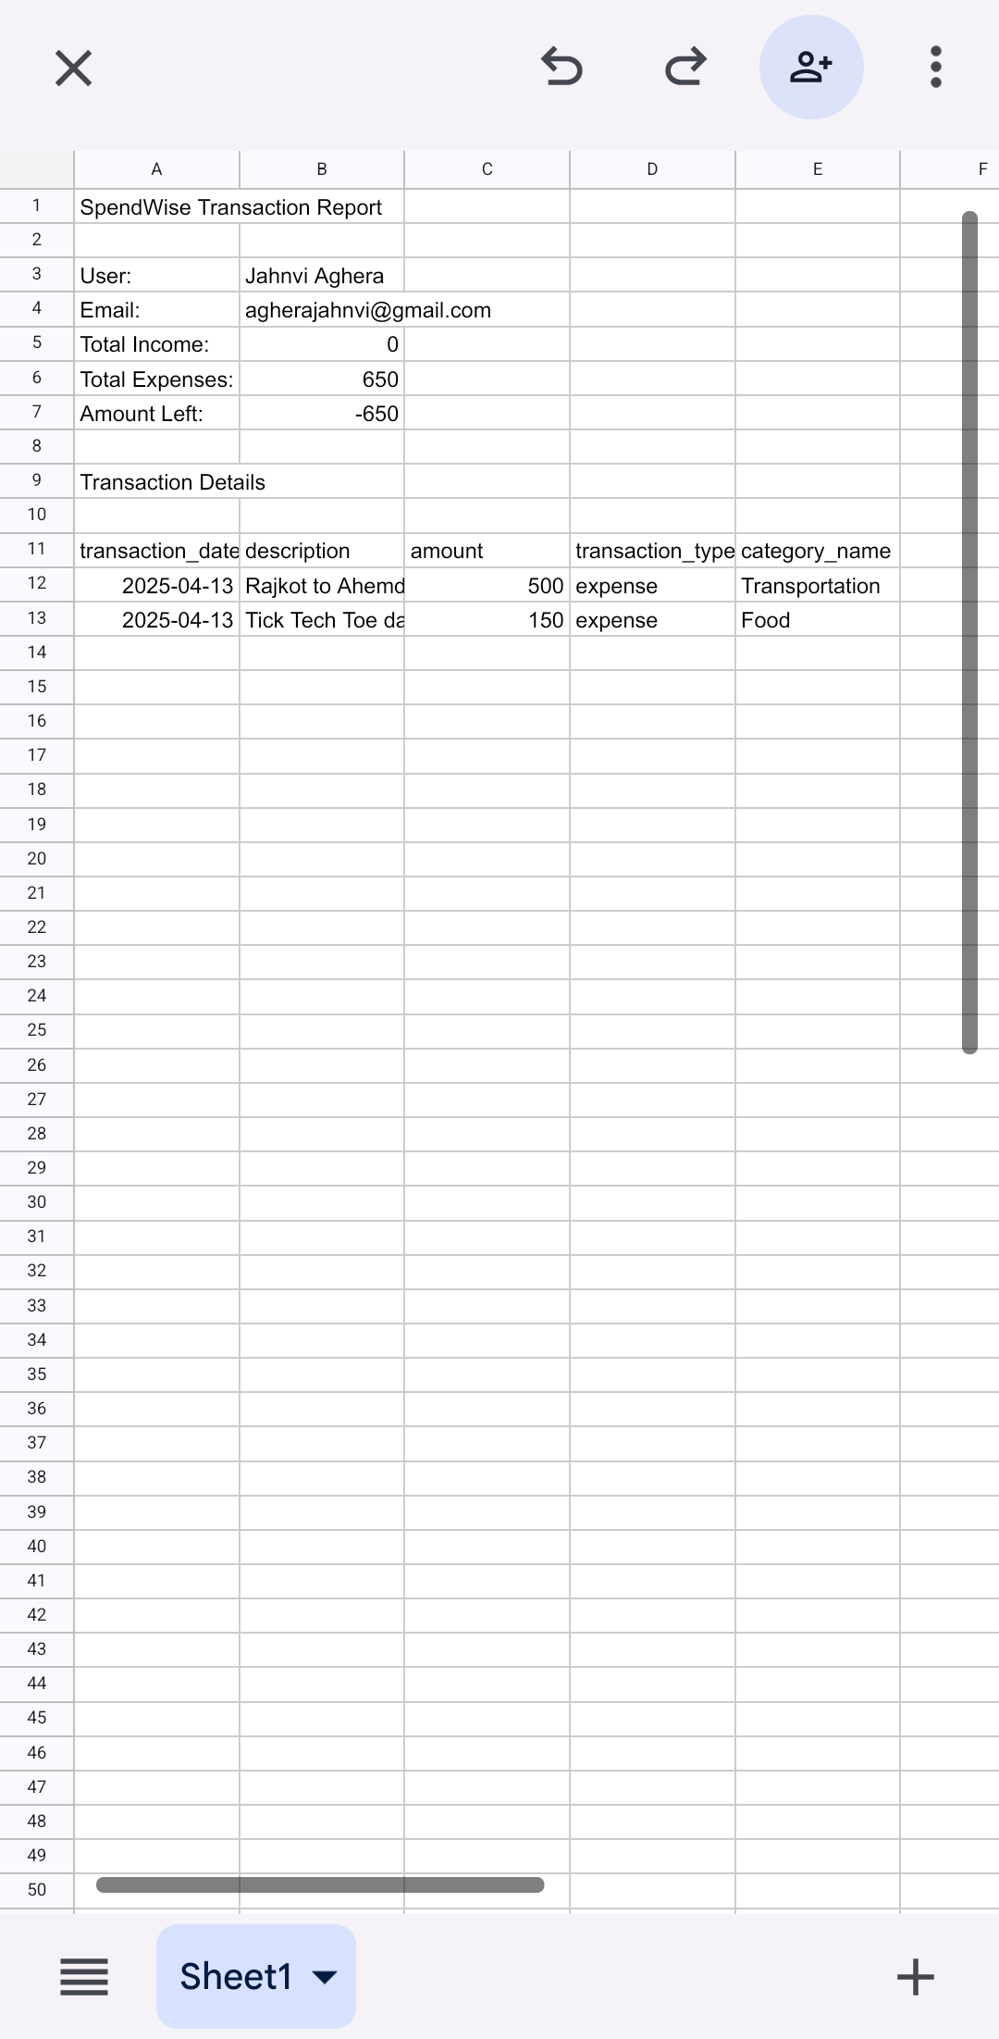

Slide 40
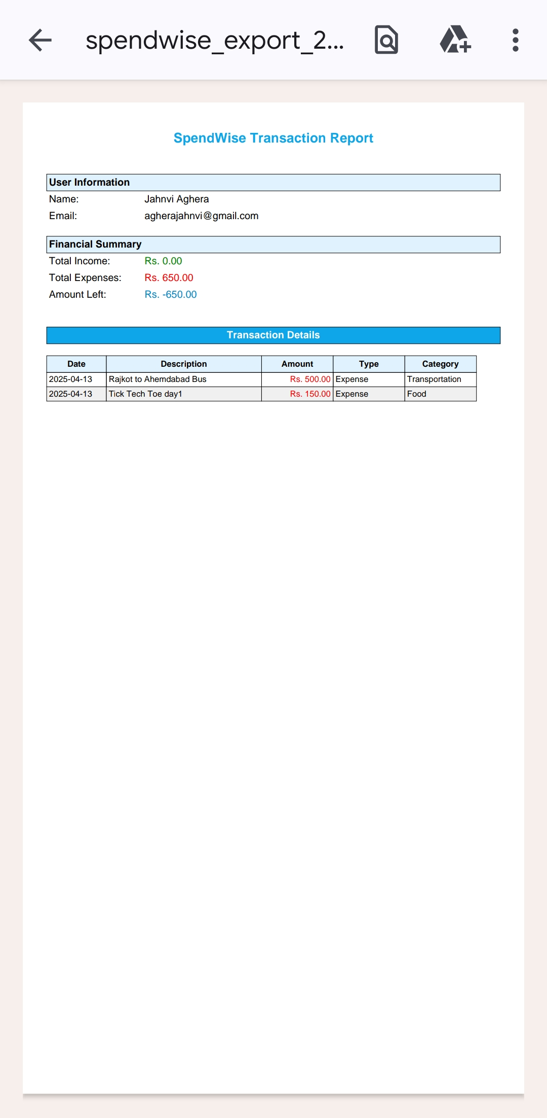

Slide 42
User Profile Management

Slide 43
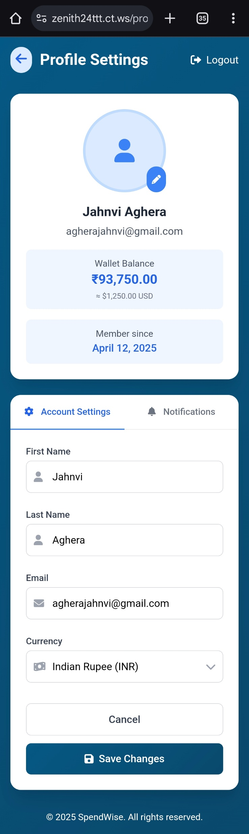

Slide 45
AI Assistance

Slide 46
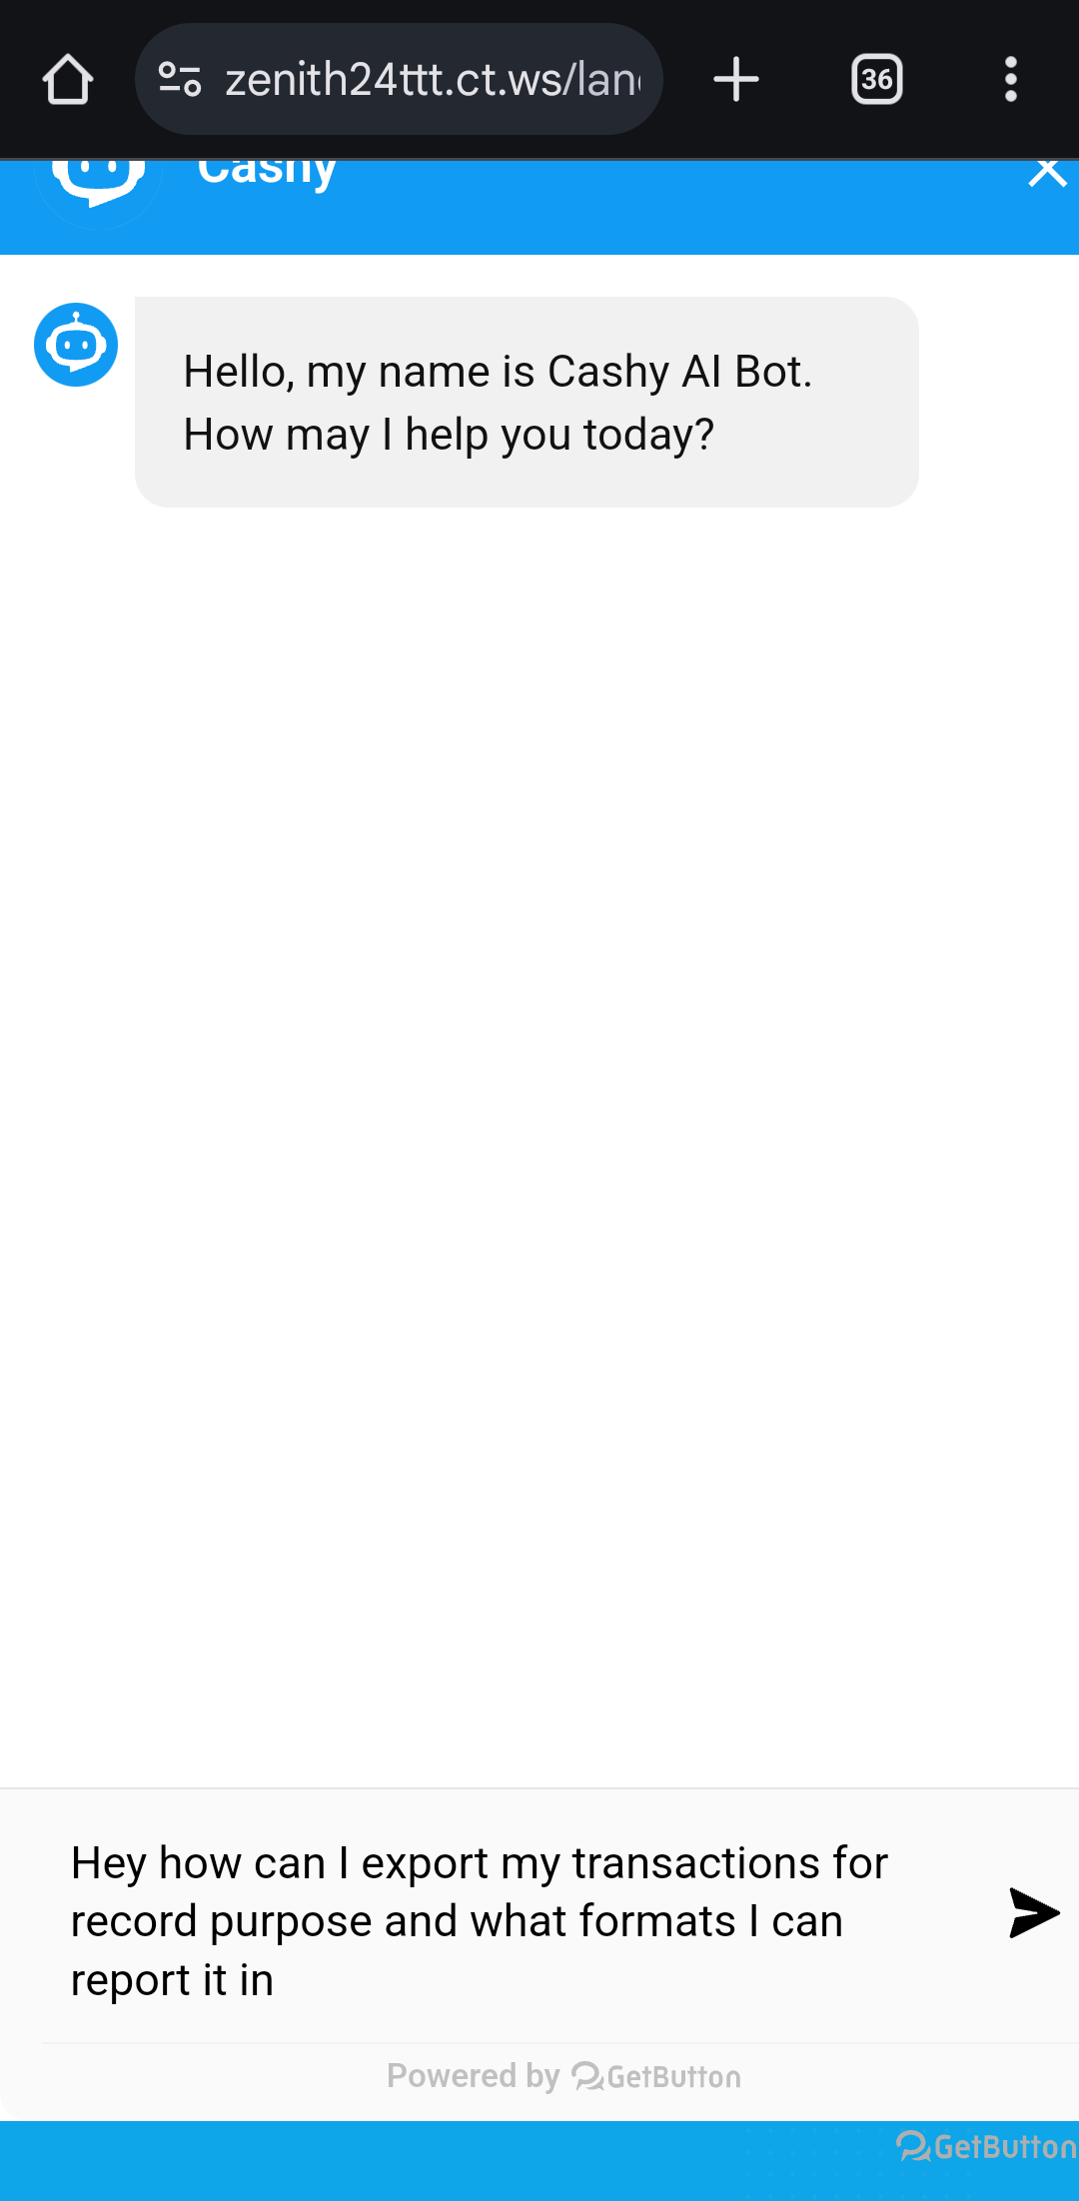

Slide 48
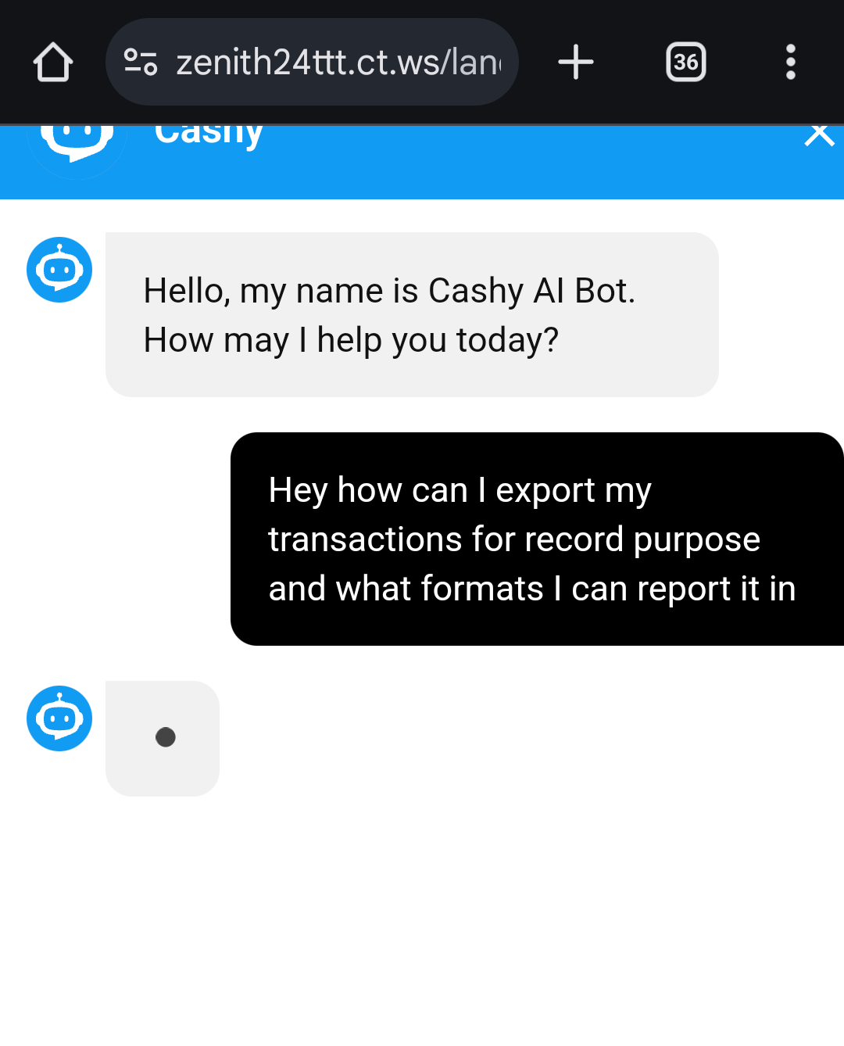

Slide 50
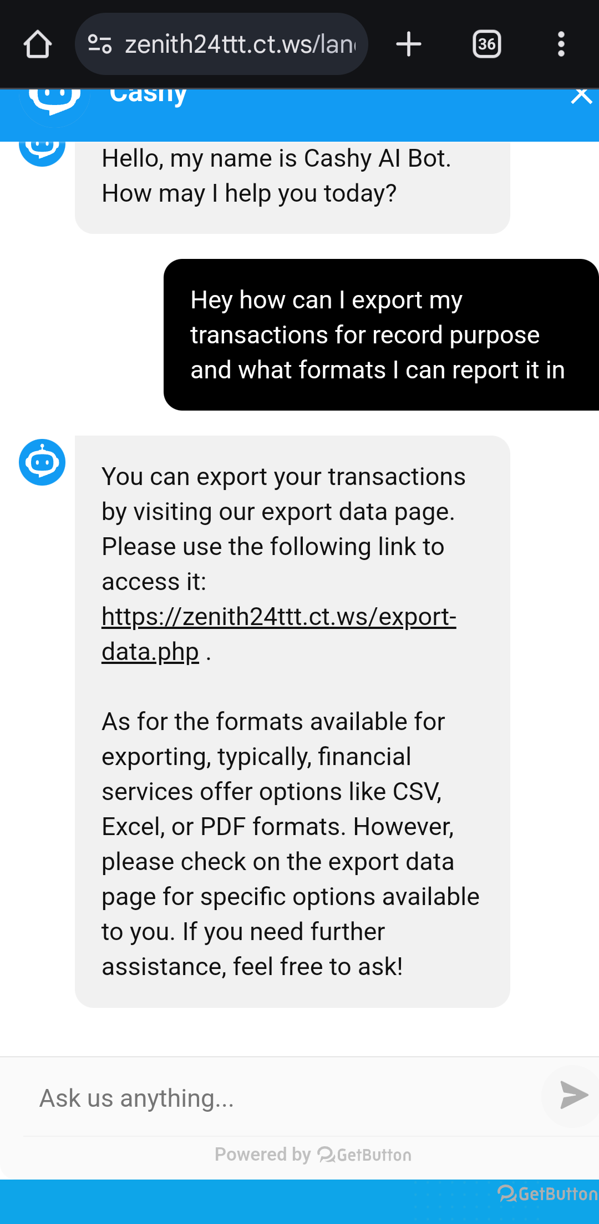

Slide 51
1
FUTURE ENHANCEMENTS
Add AI-based financial insights and recommendations (e.g., savings tips).
2
Integrate third-party APIs for bank account synchronization
3
Support multiple currencies for global users

Slide 52
THANKS
Do you have any questions?
iampayal018@gmail.com
agherajahnvi@gmail.com
adivid198986@gmail.com

